Slide 1
CHURN ASSIGNMENT
By QADIR BUX

Slide 2
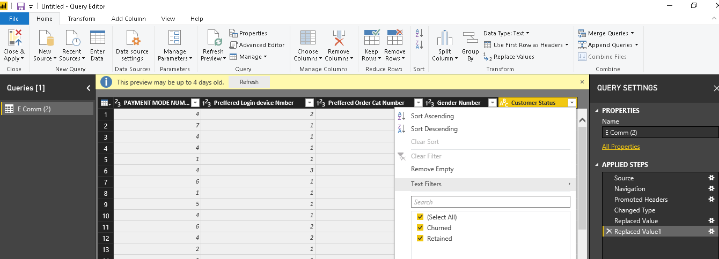
CUSTOMER STATUS

Slide 3
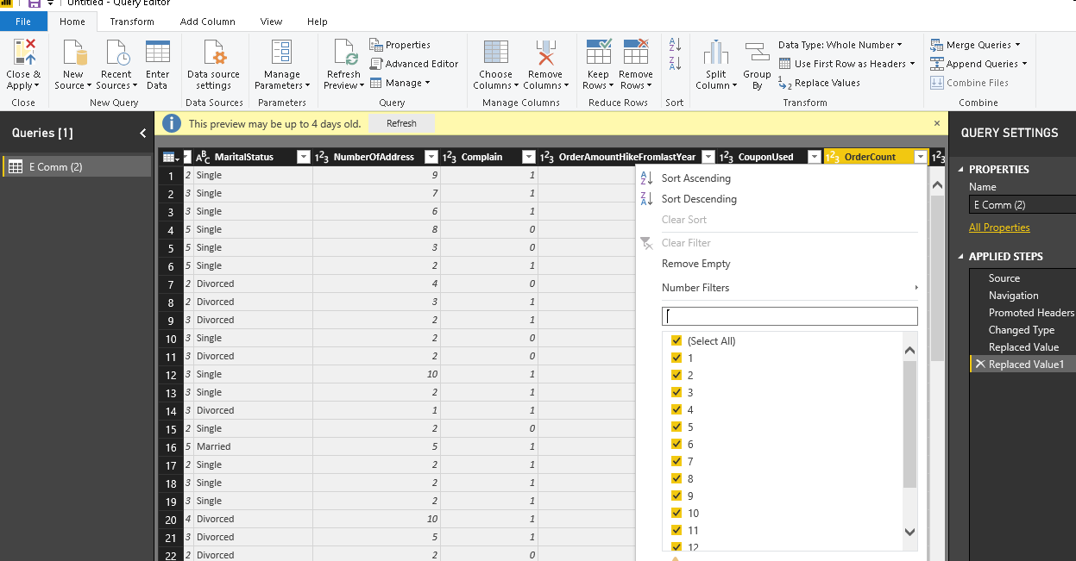
REMOVED NULL

Slide 4
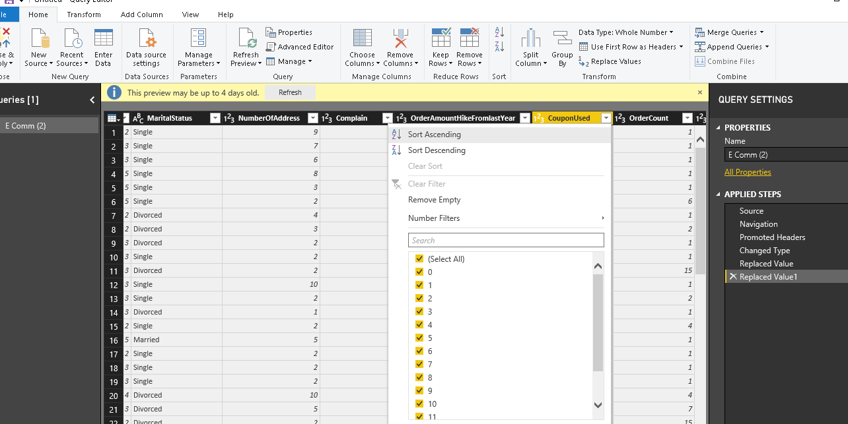
CLEANING REPLACED WITH 0

Slide 5
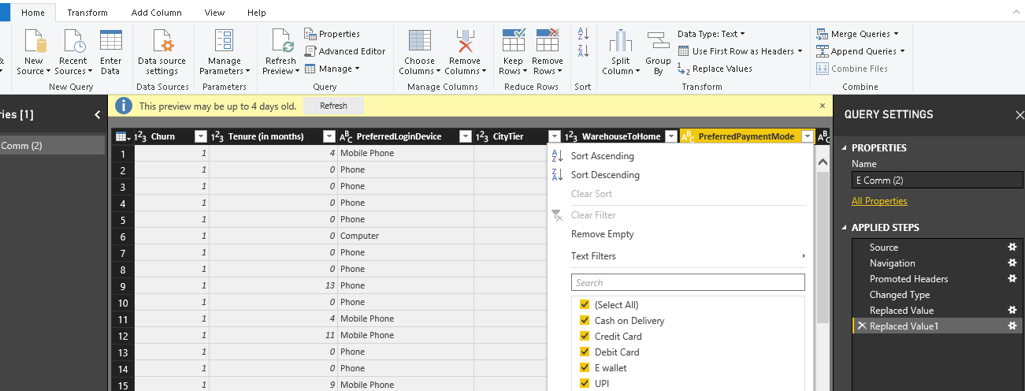
COD & CC

Slide 6
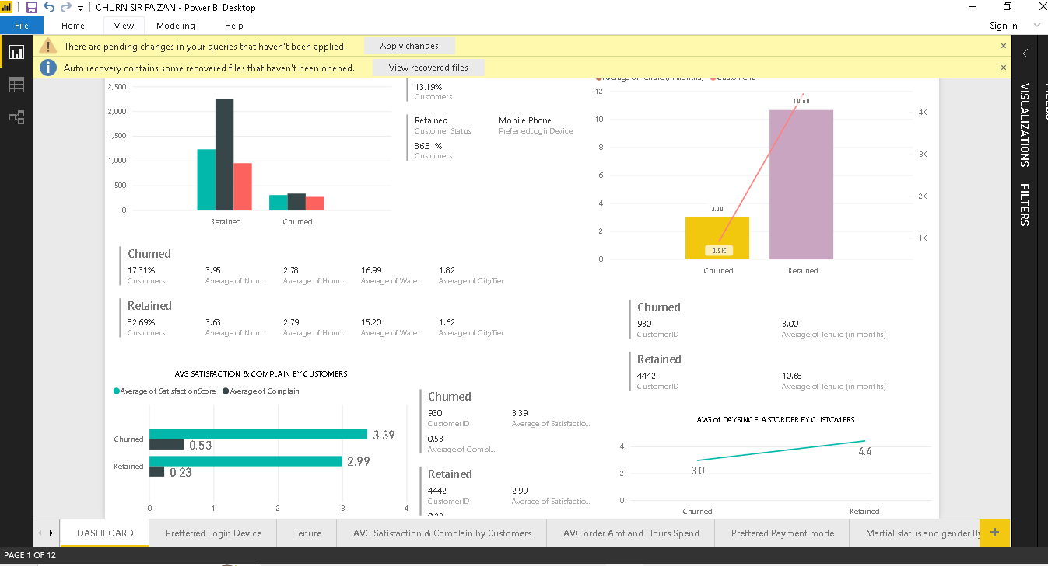
DASHBOARD

Slide 7
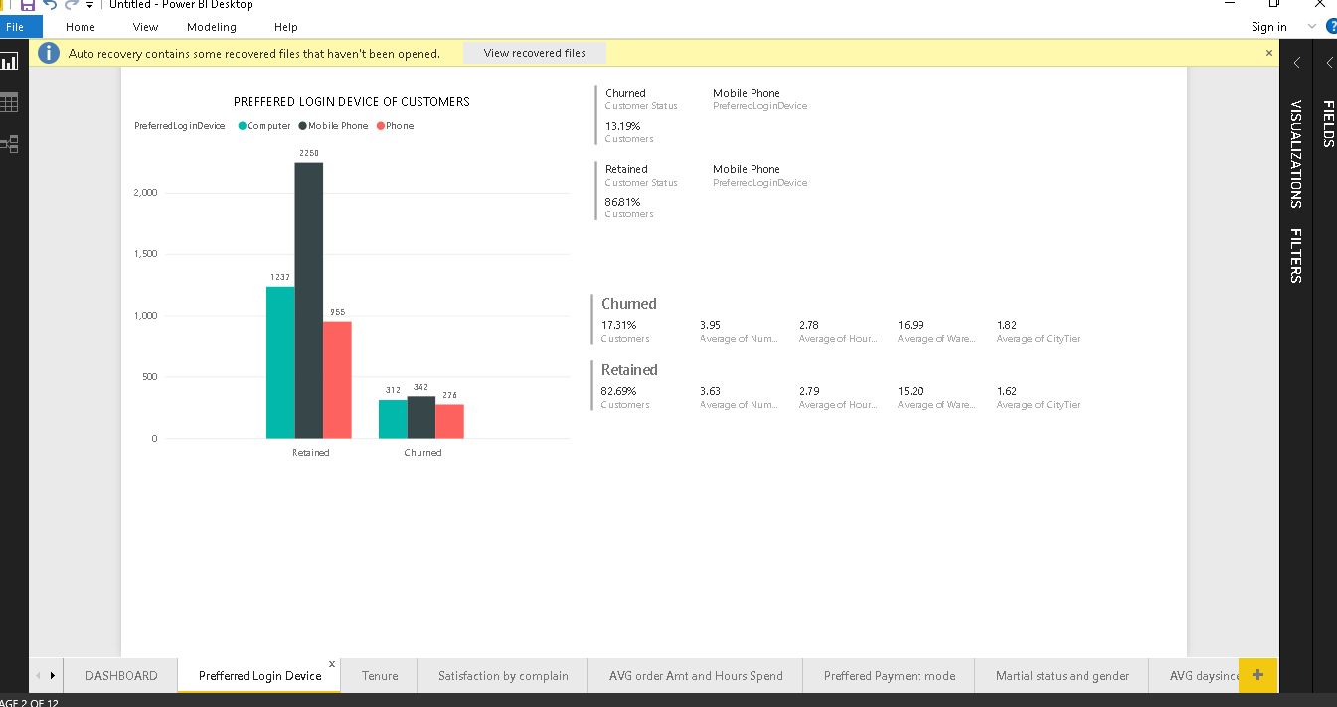
PREFFERED LOGIN DEVICE

Slide 8
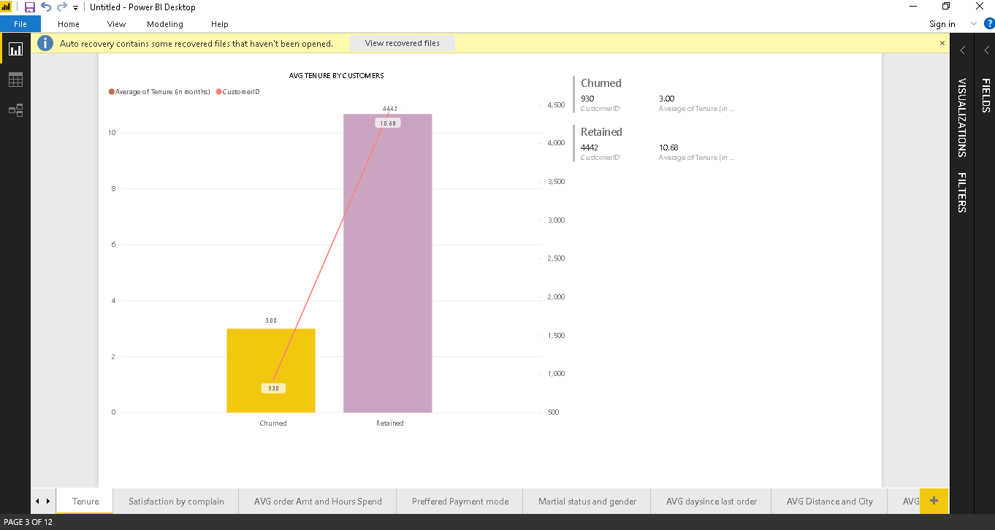
AVG TENURE BY CUSTOMERS STATUS

Slide 9
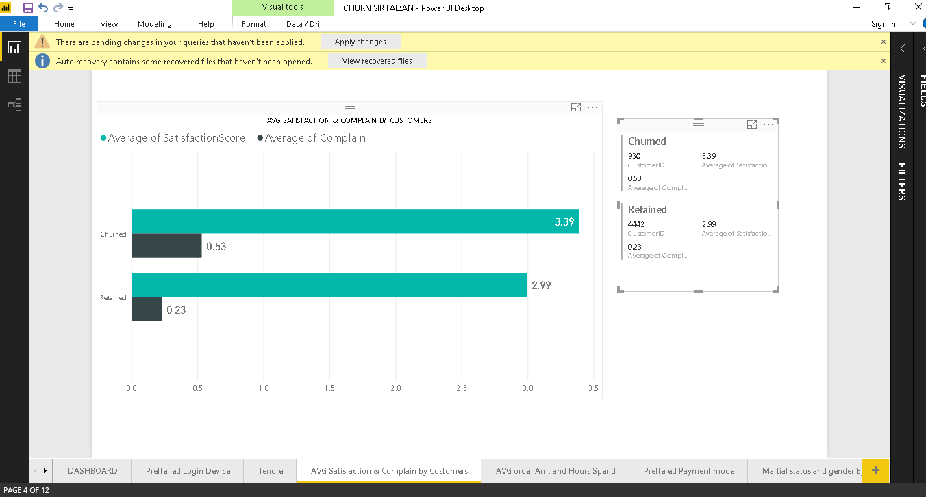
AVG SATISFACTION SCORE

Slide 10
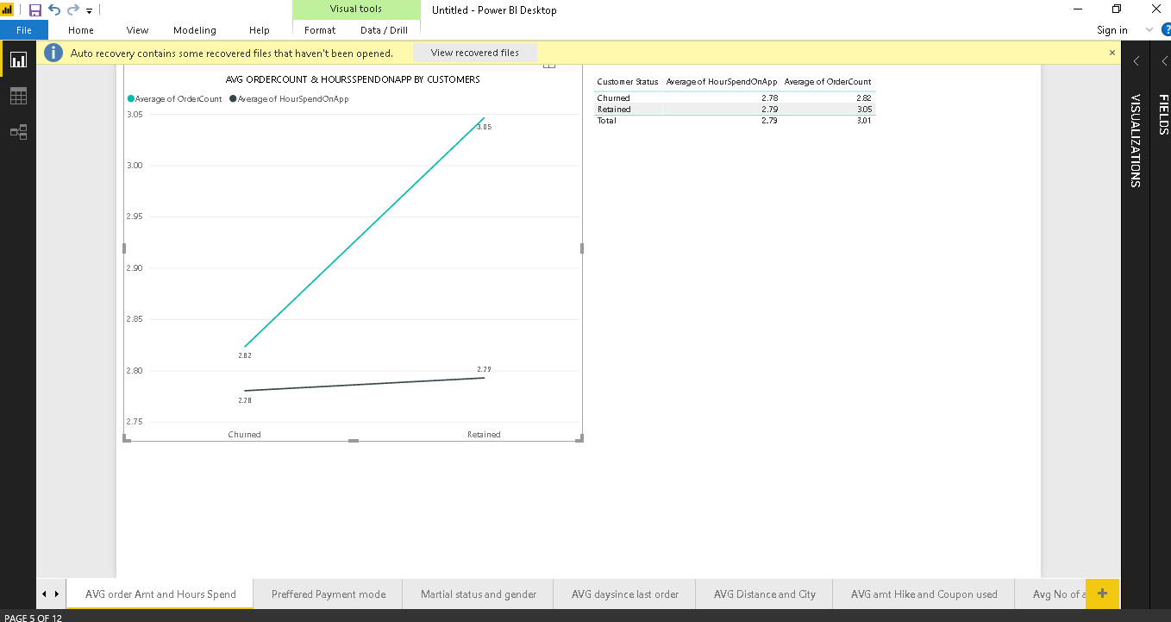
AVG ORDERCOUNT AND AVG HOUR SPENT

Slide 11
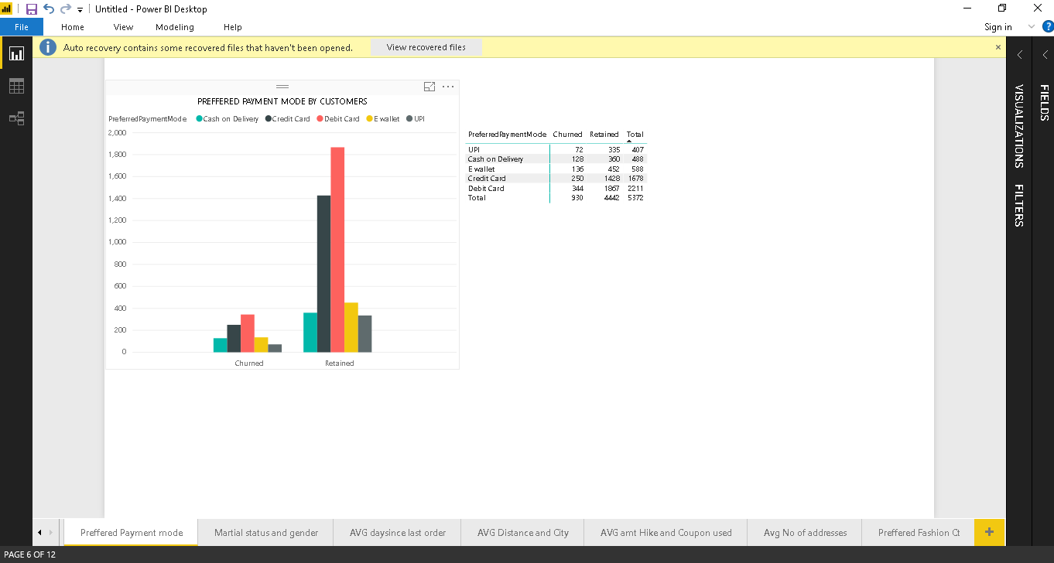
PREFFERED BY PAYMENT MODE

Slide 12
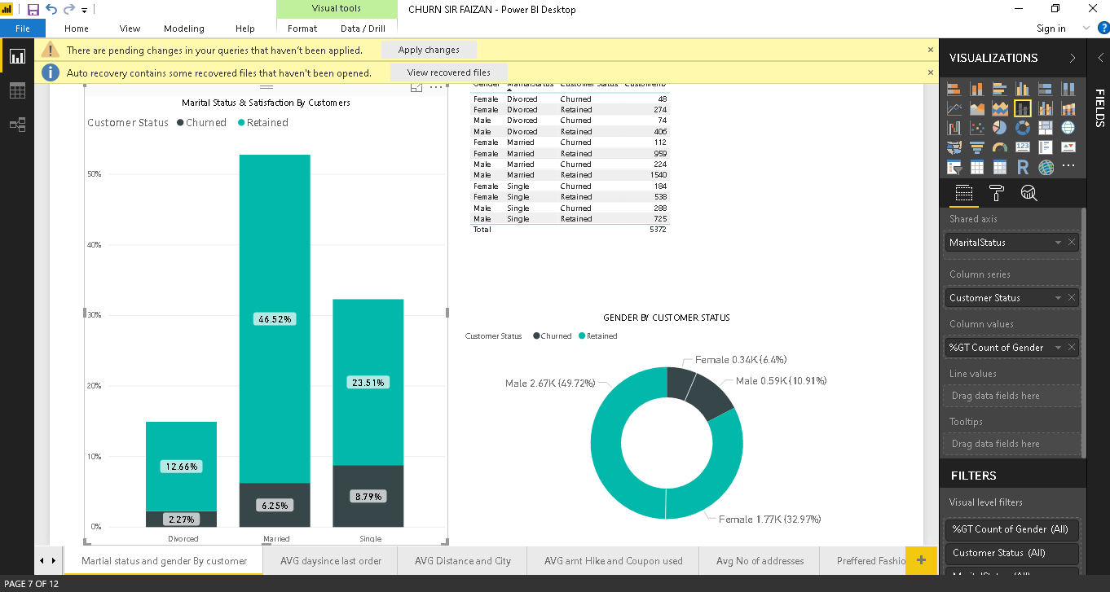
VISUALS OF GENDERS BY CUSTOMERS STATUS

Slide 13
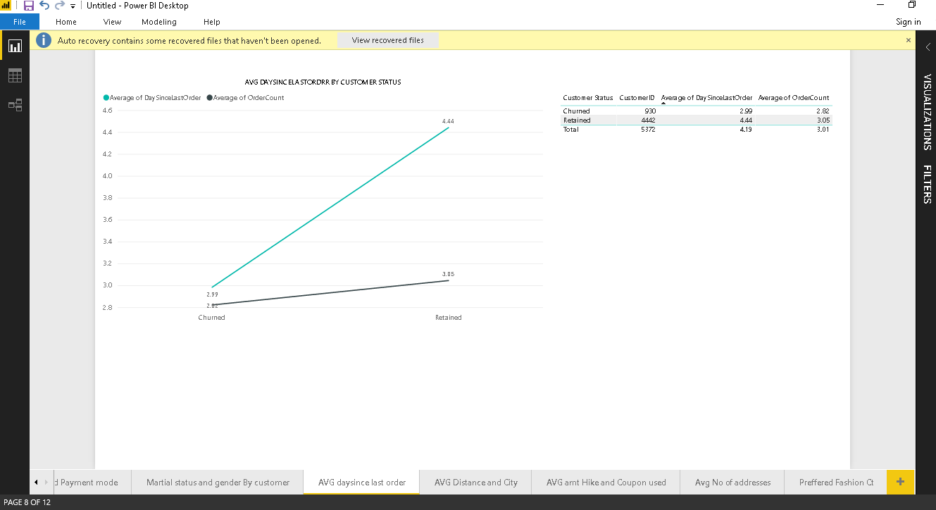
AVG DaySinceLast Order by Customers Status

Slide 14
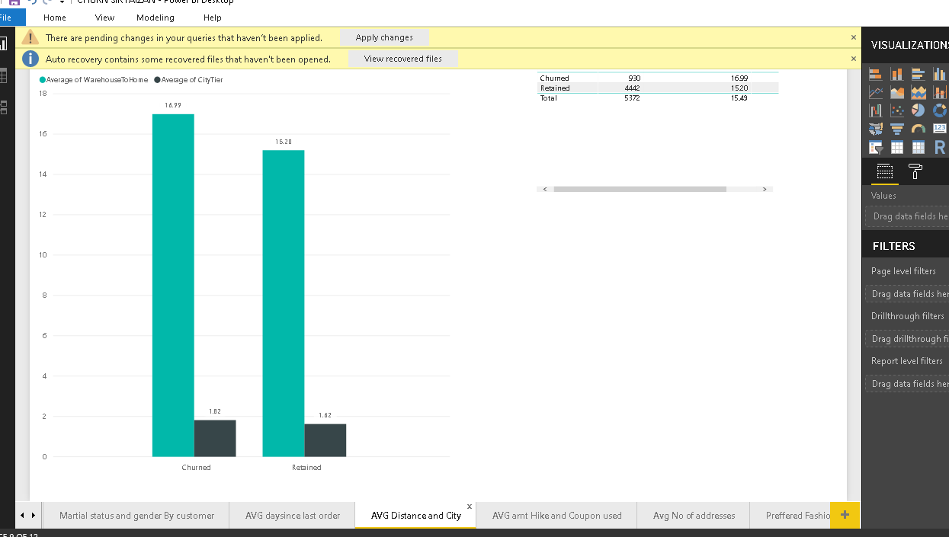
THE AVERAGE DISTANCE FROM WAREHOUSE

Slide 15
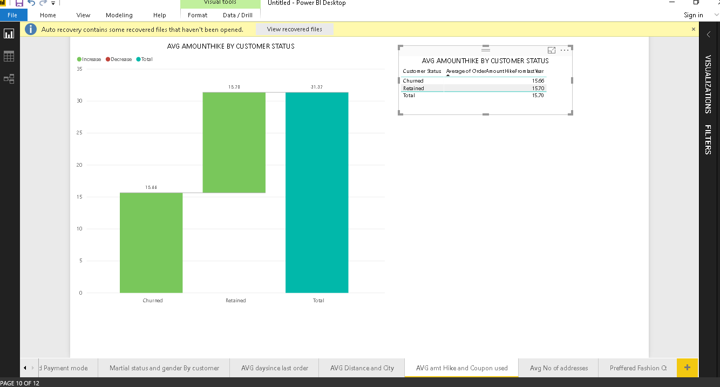
AVG AMOUNT HIKE

Slide 16
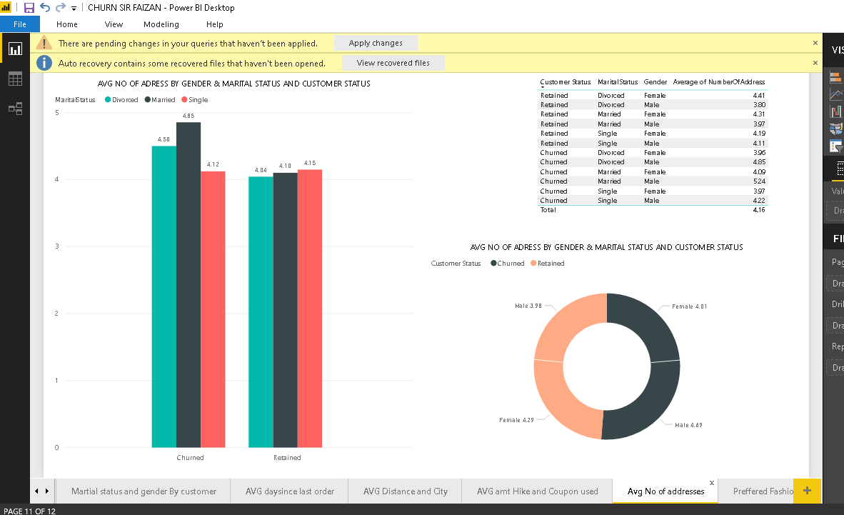
AVG NO OF ADDRESS BY GENDER

Slide 17
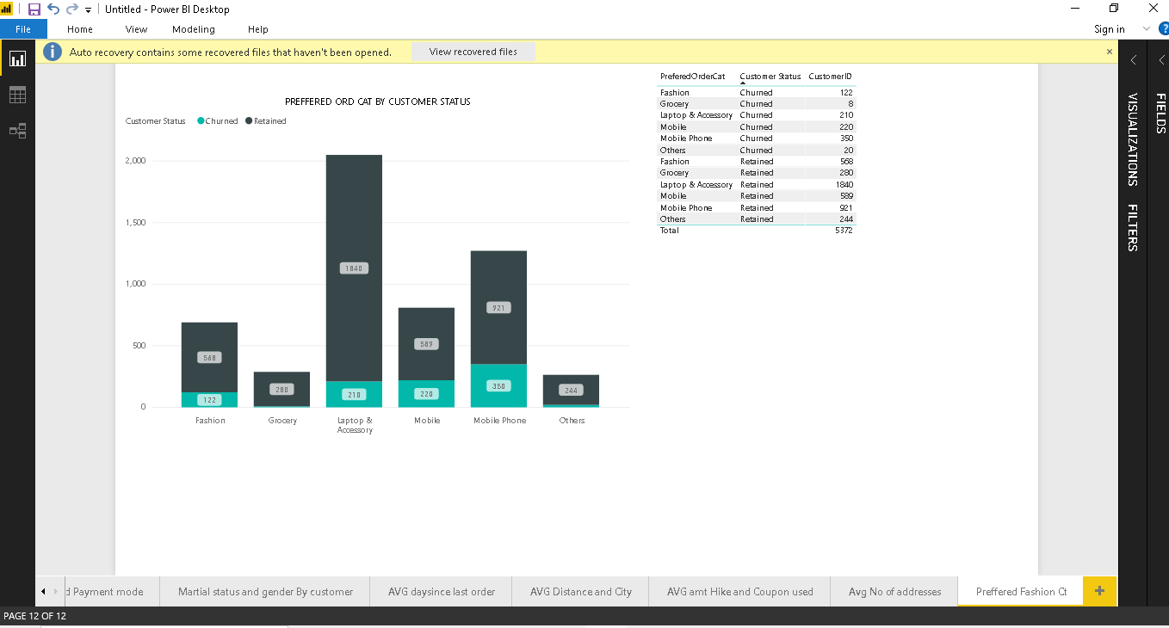
PREFFERED CATEGORY

Slide 18
INSIGHTS
Mobile app was the preffered device among retained 86.81% and churned customers 13.81%.
AVG tenure of Retained Customer was very high with 10.69 while Churned Customer had 3.00
AVG Satisfation of ChurnedCustomers was high with 0.53 and Retained Customer with 0.23 which is because the AVG Complain of Churned was 3.39 and Retained was 2.99
Retained Customer and Churned customer had same amount of time spent on app but the order count of retained was high with 3.05 while churned customers had 2.82
Debit Card was the most preffered Payment mode used in both retained and churned customers.
Males are our main customers with retained 50% and 10% churned
More specifically Married Males were retained with 32.%
AVG Day since last order was 4.44% of Retained customers and their order count was 3.05
AVG distance to ware house was high of churned customers and also their AVG City tier was high too
AVG Amount Hike since Last year of both Retained and churned Customers was almost same
In Preffered order category Laptop and Accessory were sold the most by retained customers

Slide 19
RECOMMENDATIONS
Company should make the mobile app more user friendly and more appealing so that the remaining 13% churned must not churn
Company must engage their customer and make strategies so that customer stays for longer period their chances of retaining customers can increase or they might find out why customers churns within 3 months and improve that
They must keep offers on debit cards and credit card as they are the preffered payment modes
They must engage their customers by getting feedback so that they can know what is wrong in them as everyone does not complain instead they churn so the better strategy is to get feedback from them
Target Males as they are our main customers and introduce more products in male category more specifically married males

